Slide 1

Pennant Technologies Private Limited
Springs in Java

Slide 4
Spring Framework
It was developed by Rod Johnson in 2003.
Spring framework makes the easy development of JavaEE application.
Spring is a lightweight framework.
It can be thought of as a framework of frameworks because it provides support to various frameworks such as Struts, Hibernate, Tapestry, EJB, JSF, etc.
The framework, in broader sense, can be defined as a structure where we find solution of the various technical problems.
The Spring framework comprises several modules such as IOC, AOP, DAO, Context, ORM, WEB MVC etc.

Slide 5
Inversion Of Control (IOC) and Dependency Injection
These are the design patterns that are used to remove dependency from the programming code. They make the code easier to test and maintain.
ex: class Employee{
Address address;
Employee(){
address=new Address();
}
} In such case, there is dependency between the Employee and Address (tight coupling). Advantage of Dependency Injection makes the code loosely coupled so easy to maintain makes the code easy to test
class Employee{
Address address;
Employee(Address address){
this.address=address;
}
}
Thus, IOC makes the code loosely coupled. In such case, there is no need to modify the code if our logic is moved to new environment.
In Spring framework, IOC container is responsible to inject the dependency.
We provide metadata to the IOC container either by XML file or annotation.

Slide 6
Advantages of Spring Framework
1) Predefined Templates:
Spring framework provides templates for JDBC, Hibernate, JPA etc. technologies.
So there is no need to write too much code.
It hides the basic steps of these technologies.
Let's take the example of JdbcTemplate, you don't need to write the code for exception handling, creating connection, creating statement, committing transaction, closing connection etc.
You need to write the code of executing query only.
Thus, it save a lot of JDBC code.
2) Powerful abstraction
It provides powerful abstraction to JavaEE specifications such as JMS, JDBC, JPA and JTA.
3) Declarative support
It provides declarative support for caching, validation, transactions and formatting.

Slide 7
Advantages of Spring Framework
4) Loose Coupling
The Spring applications are loosely coupled because of dependency injection.
5) Easy to test
The Dependency Injection makes easier to test the application. The EJB or Struts application require server to run the application but Spring framework doesn't require server.
6) Lightweight
Spring framework is lightweight because of its POJO implementation. The Spring Framework doesn't force the programmer to inherit any class or implement any interface. That is why it is said non-invasive.
7) Fast Development
The Dependency Injection feature of Spring Framework and it support to various frameworks makes the easy development of JavaEE application.

Slide 8
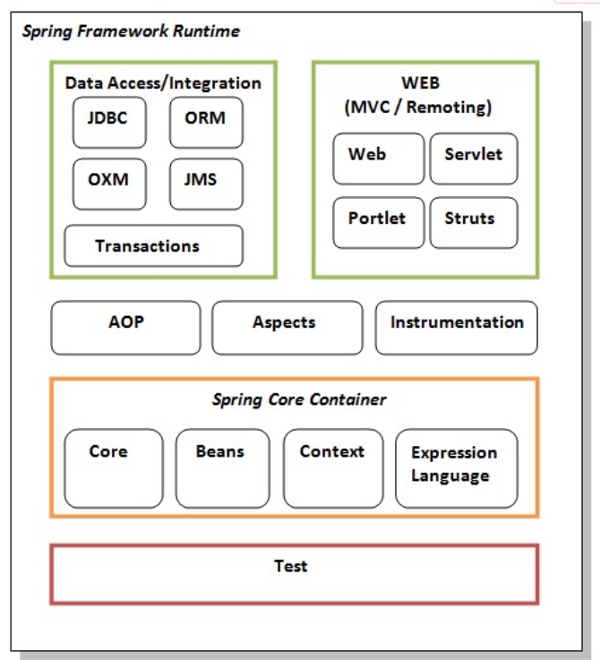
Spring Modules
The Spring framework comprises of many modules such as core, beans, context, expression language, AOP, Aspects, Instrumentation, JDBC, ORM, OXM, JMS, Transaction, Web, Servlet, Struts etc. These modules are grouped into Test, Core Container, AOP, Aspects, Instrumentation, Data Access / Integration, Web (MVC / Remoting) as displayed in the following diagram.

Slide 9
Spring Modules
Test
This layer provides support of testing with JUnit and TestNG.
Spring Core Container
The Spring Core container contains core, beans, context and expression language (EL) modules.
Core and Beans
These modules provide IOC and Dependency Injection features.
Context
This module supports internationalization (I18N), EJB, JMS, Basic Remoting.
Expression Language
It is an extension to the EL defined in JSP. It provides support to setting and getting property values, method invocation, accessing collections and indexers, named variables, logical and arithmetic operators, retrieval of objects by name etc.
AOP, Aspects and Instrumentation
These modules support aspect oriented programming implementation where you can use Advices, Pointcuts etc. to decouple the code.
The aspects module provides support to integration with AspectJ.
The instrumentation module provides support to class instrumentation and classloader implementations.
Data Access / Integration
This group comprises of JDBC, ORM, OXM, JMS and Transaction modules. These modules basically provide support to interact with the database.
Web
This group comprises of Web, Web-Servlet, Web-Struts and Web-Portlet. These modules provide support to create web application.

Slide 10
Spring Example
Here, we are going to learn the simple steps to create the first spring application.
To run this application, we are not using any IDE.
We are simply using the command prompt.
Let's see the simple steps to create the spring application
create the class
create the xml file to provide the values
create the test class
Load the spring jar files
Run the test class

Slide 11
Create Java class
public class Student {
private String name;
public String getName() {
return name; }
public void setName(String name) {
this.name = name; }
public void displayInfo(){
System.out.println("Hello: "+name); }
}

Slide 12
Create the xml file
<?xml version="1.0" encoding="UTF-8"?>
<beans
xmlns="http://www.springframework.org/schema/beans"
xmlns:xsi="http://www.w3.org/2001/XMLSchema-instance"
xmlns:p="http://www.springframework.org/schema/p"
xsi:schemaLocation="http://www.springframework.org/schema/beans
http://www.springframework.org/schema/beans/spring-beans-3.0.xsd">
<bean id="studentbean" class="com.javatpoint.Student">
<property name="name" value="Vimal Jaiswal"></property>
</bean>
</beans>

Slide 13
Create the test class and Load the jar files required for spring framework
import org.springframework.beans.factory.BeanFactory;
import org.springframework.beans.factory.xml.XmlBeanFactory;
import org.springframework.core.io.ClassPathResource;
import org.springframework.core.io.Resource;
public class Test {
public static void main(String[] args) {
Resource resource=new ClassPathResource("applicationContext.xml");
BeanFactory factory=new XmlBeanFactory(resource);
Student student=(Student)factory.getBean("studentbean");
student.displayInfo();
} }
There are mainly three jar files required to run this application.
org.springframework.core-3.0.1.RELEASE-A
com.springsource.org.apache.commons.logging-1.1.1
org.springframework.beans-3.0.1.RELEASE-A

Slide 14
Steps to create spring application in Eclipse IDE
1) Create the Java Project
Go to File menu - New - project - Java Project. Write the project name e.g. firstspring - Finish. Now the java project is created.
2) Add spring jar files
There are mainly three jar files required to run this application.
org.springframework.core-3.0.1.RELEASE-A
com.springsource.org.apache.commons.logging-1.1.1
org.springframework.beans-3.0.1.RELEASE-A
To load the jar files in eclipse IDE, Right click on your project - Build Path - Add external archives - select all the required jar files - finish..
To create the java class, Right click on src - New - class - Write the class name e.g. Student - finish.

Slide 15
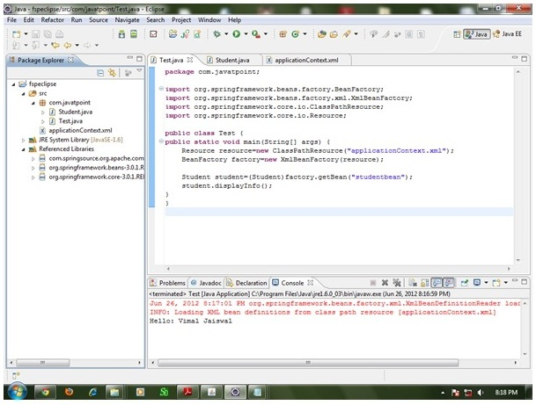

Slide 16
IoC Container
The IoC container is responsible to instantiate, configure and assemble the objects. The IoC container gets informations from the XML file and works accordingly. The main tasks performed by IoC container are:
to instantiate the application class
to configure the object
to assemble the dependencies between the objects
There are two types of IoC containers. They are:
BeanFactory
ApplicationContext
Difference between BeanFactory and the ApplicationContext
The org.springframework.beans.factory.BeanFactory and the org.springframework.context.ApplicationContext interfaces acts as the IoC container.
The ApplicationContext interface is built on top of the BeanFactory interface.
It adds some extra functionality than BeanFactory such as simple integration with Spring's AOP, message resource handling (for I18N), event propagation, application layer specific context (e.g. WebApplicationContext) for web application.
So it is better to use ApplicationContext than BeanFactory.

Slide 17
Using BeanFactory and Using ApplicationContext
The XmlBeanFactory is the implementation class for the BeanFactory interface. To use the BeanFactory, we need to create the instance of XmlBeanFactory class as given below:
Resource resource=new ClassPathResource("applicationContext.xml");
BeanFactory factory=new XmlBeanFactory(resource);
The constructor of XmlBeanFactory class receives the Resource object so we need to pass the resource object to create the object of BeanFactory.
Using ApplicationContext
The ClassPathXmlApplicationContext class is the implementation class of ApplicationContext interface. We need to instantiate the ClassPathXmlApplicationContext class to use the ApplicationContext as given below:
ApplicationContext context = new ClassPathXmlApplicationContext("applicationContext.xml");
The constructor of ClassPathXmlApplicationContext class receives string, so we can pass the name of the xml file to create the instance of ApplicationContext.

Slide 18
Dependency Injection in Spring
Dependency Injection (DI) is a design pattern that removes the dependency from the programming code so that it can be easy to manage and test the application. Dependency Injection makes our programming code loosely coupled. To understand the DI better, Let's understand the Dependency Lookup (DL) first:
Dependency Lookup
The Dependency Lookup is an approach where we get the resource after demand. There can be various ways to get the resource for example:
A obj = new AImpl();
In such way, we get the resource(instance of A class) directly by new keyword. Another way is factory method:
A obj = A.getA();
This way, we get the resource (instance of A class) by calling the static factory method getA().

Slide 19
Problems of Dependency Lookup
Alternatively, we can get the resource by JNDI (Java Naming Directory Interface) as:
Context ctx = new InitialContext();
Context environmentCtx = (Context) ctx.lookup("java:comp/env");
A obj = (A)environmentCtx.lookup("A");
There can be various ways to get the resource to obtain the resource.
There are mainly two problems of dependency lookup.
tight coupling The dependency lookup approach makes the code tightly coupled. If resource is changed, we need to perform a lot of modification in the code.
Not easy for testing This approach creates a lot of problems while testing the application especially in black box testing.
Two ways to perform Dependency Injection in Spring framework
Spring framework provides two ways to inject dependency
By Constructor
By Setter method

Slide 20
Dependency Injection
The Dependency Injection is a design pattern that removes the dependency of the programs. In such case we provide the information from the external source such as XML file. It makes our code loosely coupled and easier for testing. In such case we write the code as:
class Employee{
Address address;
Employee(Address address){
this.address=address;
}
public void setAddress(Address address){
this.address=address;
} }
In such case, instance of Address class is provided by external souce such as XML file either by constructor or setter method.

Slide 21
Dependency Injection by Constructor Example
We can inject the dependency by constructor. The <constructor-arg> subelement of <bean> is used for constructor injection. Here we are going to inject
primitive and String-based values
Dependent object (contained object)
Collection values etc.
Injecting primitive and string-based values
Let's see the simple example to inject primitive and string-based values. We have created three files here:
Employee.java
applicationContext.xml
Test.java

Slide 22
Employee.java
applicationContext.xml
public class Employee {
private int id;
private String name;
public Employee() {System.out.println("def cons");}
public Employee(int id) {this.id = id;}
public Employee(String name) { this.name = name;}
public Employee(int id, String name) {
this.id = id;
this.name = name;
}
void show(){
System.out.println(id+" "+name);
}
}
<?xml version="1.0" encoding="UTF-8"?>
<beans
xmlns="http://www.springframework.org/schema/beans" xmlns:xsi="http://www.w3.org/2001/XMLSchema-instance"
xmlns:p="http://www.springframework.org/schema/p" xsi:schemaLocation="http://www.springframework.org/schema/beans http://www.springframework.org/schema/beans/spring-beans-3.0.xsd">
<bean id="e" class="com.javatpoint.Employee">
<constructor-arg value="10" type="int"></constructor-arg>
</bean>
</beans>

Slide 23
Test.java
Injecting string-based values
import org.springframework.beans.factory.BeanFactory;
import org.springframework.beans.factory.xml.XmlBeanFactory;
import org.springframework.core.io.*;
public class Test {
public static void main(String[] args) {
Resource r=new ClassPathResource("applicationContext.xml");
BeanFactory factory=new XmlBeanFactory(r);
Employee s=(Employee)factory.getBean("e");
s.show(); } }
Output:10 null
If you don't specify the type attribute in the constructor-arg element, by default string type constructor will be invoked.
....
<bean id="e" class="com.javatpoint.Employee">
<constructor-arg value="10"></constructor-arg>
</bean>
....
If you change the bean element as given above, string parameter constructor will be invoked and the output will be 0 10.
Output:0 10

Slide 24
Injecting string-based values
You may also pass the string literal as following:
....
<bean id="e" class="com.javatpoint.Employee">
<constructor-arg value="Sonoo"></constructor-arg>
</bean>
....
Output:0 Sonoo
You may pass integer literal and string both as following
....
<bean id="e" class="com.javatpoint.Employee">
<constructor-arg value="10" type="int" ></constructor-arg>
<constructor-arg value="Sonoo"></constructor-arg>
</bean>
....
Output:10 Sonoo

